Slide 1
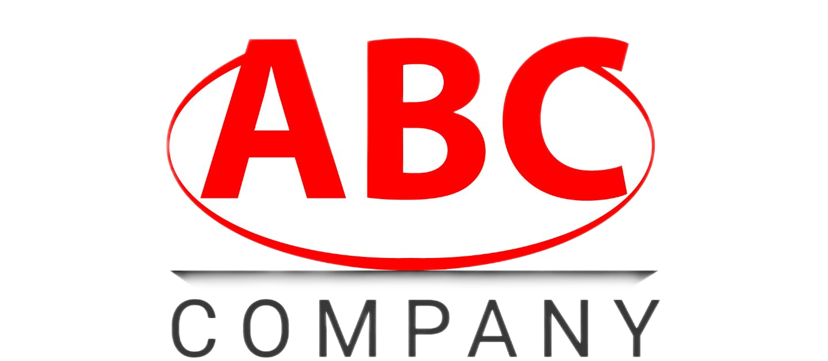
ABC Company Analysis
Presented by: Team 5 — Unnati Agrawal, Hetal Virendrabhai Gandhi, Zadia Navarro, Anandi Singh, Akanksha Shrivastava, and Payal Sinha
Notes:
Slide 1: Introduction
(introductions) Today, we will be presenting a process improvement plan for Company ABC, focusing on their procurement and quality management processes.

Slide 2
Table of contents
01
02
03
Introduction
Methods
Gaps
04
05
06
Suggestions
Risks & ROI
Conclusion
What is the current situation?
Describe the methods used to detail the ‘As Is’ process
Identify the largest gaps in the process
Improvement suggestions
Risk management issues and ROI calculations
Case findings summary
Notes:
Before we get started, I will go through the problem we identified, our methods for analysis, gaps we uncovered, our suggested improvements, Risks and the projected impact of these changes

Slide 3
01
Introduction
What is the problem and business outcome that needs to be solved by a process improvement?
Notes:
(Read question one)
For starters, the introduction
What is the problem and business outcome that needs to be solved by a process improvement
A description of what you believe is the problem and what you believe is the business outcome that needs to be solved by a process improvement.

Slide 4
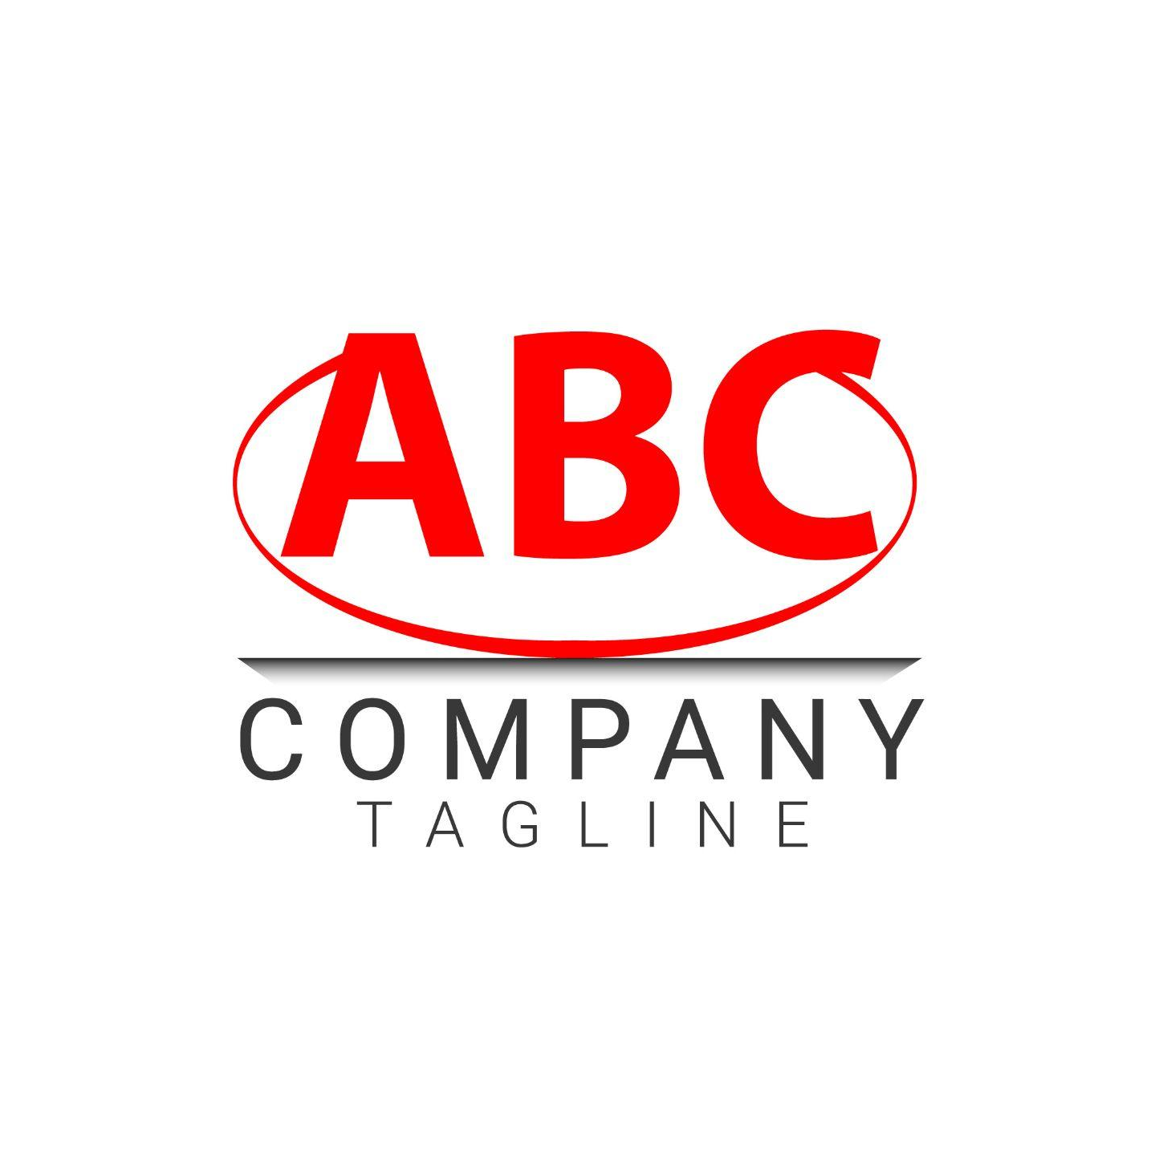
What is the current situation?
Business Problem
The company faces low first-time rate for raw materials, causing customer complaints, operational delays and financial losses
Business Improvement
The business outcome proposed is to increase first-quality acceptance rate by 30%
Notes:
Slide 4: Problem & Business Outcome
The business problem identified is that ABC Company has a low first-time pass rate for raw materials, causing customer complaints, operational delays, and financial losses. This problem is compounded by poor vendor collaboration, misaligned incentives, and inconsistent internal processes.
—
Company ABC, a manufacturer of plastic components with international operations, is facing a significant deterioration in first-time pass rates for raw materials used in production. The lapse in quality is not an isolated issue; it originates from a combination of process failures, misaligned incentives, poor supplier engagement, ineffective training on new systems, and an outdated approach to procurement that contradicts the strategic direction of the organization under new leadership. As a result, ABC Company is experiencing downstream quality defects, customer complaints, and reputational damage, leading to customer attrition and revenue risk.
—-
The business outcome:
Increase the first-pass quality acceptance rate by 30% while strengthening vendor relationships and streamlining quality control.
—
To restore customer trust, reduce defects, and align with strategic leadership, ABC must improve first-time pass rates for raw material deliveries by at least 30% within 12 months. Achieving this goal will require quantifiable outcomes and strategic alignment outcomes.

Slide 5
02
Methods
Describe the methods used to detail the ‘As Is’ process
Notes:
Question 2
Describe the methods/tools you would use to document the details of the As Is process and what the As Is process appears to be in your opinion.

Slide 6
Methods
The ‘As Is’ Process
The ‘Should Be’ Process
Process Mapping (swimlane diagram)
Staffing Profile/Activity Analysis
Focus Groups and Interviews
Document Review and Historical Data Analysis
Control Self-Assessment Tools
External Benchmarking (Primary Research)
Secondary Research
Internal Focus Groups & Interviews
Process Reengineering Techniques
Supplier Collaboration Workshops
Notes:
Slide 6: Documenting the As-Is Process
To document the current process, we used tools like process mapping and interviews with stakeholders. We also referred to historical quality data and process logs.
The As-Is process shows that procurement selects vendors based on cost, not quality. Specifications are not consistently shared with suppliers, warehouse inspections are informal and inconsistent, and ERP systems are underutilized due to lack of training.
—------------------------- —-- – —- – - - —-------------- —-------------- —--- —
Designing the Should-Be Process
For the Should-Be process, we applied tools such as benchmarking, process mapping, and collaborative workshops with key stakeholders.
In the future-state process, procurement would select vendors based on Total Cost of Ownership (TCO), including quality and delivery performance. We would formalize Supplier Quality Agreements (SQAs), implement standardized inspections, and ensure all staff are properly trained on ERP systems and SOPs.
–
External Benchmarking (Primary Research):
Conduct interviews or surveys with non-competitor companies in the same industry, such as the peer company the VP spoke with.
Learn how they specify quality standards before ordering and manage supplier relationships to mitigate risk.
Secondary Research:
Review industry reports, trade association publications, and academic literature to gather best practices.
The trade association ABC belongs to has already identified key practices such as enforcing strict incoming inspections, defining quality requirements upfront, and establishing supplier penalties — all of which should guide the new process.
Internal Focus Groups & Interviews:
Engage warehouse staff, procurement, quality assurance, and management to collaboratively define the expectations, responsibilities, and workflows needed in the improved process.
This also supports change readiness by involving employees in the solution.
Process Reengineering Techniques:
Use Root Cause Analysis and Issue Trees to identify where the current process fails.
Combine this with Process Mapping of the future state to visually design how procurement and quality checks should be performed.
Supplier Collaboration Workshops:
Work with top suppliers to co-develop a process for sharing demand forecasts and quality specifications in a controlled, non-proprietary way.
These sessions would help build trust and mutual accountability.

Slide 7
03
Gaps
Identify the largest gaps in the process
Notes:
Read question
Moving forward, identifying the
the largest gaps in the process and how would you prioritize these?

Slide 8
Gaps Identified
Gaps | Description
Lack of Supplier Quality Specifications & Enforcement | - No clear specifications or quality expectations - No enforcement mechanisms in place
Misaligned Incentives in Procurement | - Procurement staff are rewarded for cost savings, not for quality outcomes.
Outdated and Inconsistent Inspection Process | - Outdated inspection policy and not used in training - Warehouse inspections vary
Poor Vendor Communication + Forecast Sharing | - ABC Fails to share forecasts or design data = - Limits ability to plan and meet quality standards
Training Deficiency on New Systems | - Poorly trained staff in procurement and warehouse systems
Cultural Resistance and Blame-Shifting | - Shift blame to vendors - Do not take ownership for internal gaps
Notes:
Slide 8:
Lack of Supplier Quality Specifications and Enforcement
Vendors are not provided with clear specifications or quality expectations, and there are no enforcement mechanisms in place.
High: Directly causes inconsistent quality and poor first-pass rates.
Misaligned Incentives in Procurement
Procurement staff are rewarded for cost savings, not for quality outcomes.
High: Encourages cost-cutting and low-quality vendor choices.
Outdated and Inconsistent Inspection Process
Warehouse inspections vary by individual, and the inspection policy is outdated and not used in training.
Medium-High: Leads to inconsistent quality control and missed defects.
Poor Vendor Communication and Forecast Sharing
ABC does not share forecasts or design data, limiting suppliers' ability to plan and meet quality standards.
Medium: Prevents proactive quality assurance by vendors.
Training Deficiency on New Systems
Staff were poorly trained on the procurement and warehouse systems, leading to ongoing operational errors.
Medium: Contributes to data entry and receiving errors.
Cultural Resistance and Blame-Shifting
Long-tenured employees shift blame to vendors and don’t take ownership for internal gaps.
Medium-Low: Slows adoption of quality improvements and change.
_____________
Gap identified
Procurement incentives are misaligned with quality objectives.
No standardized inspection process.
Vendors are not held accountable for poor quality.
ERP tools are underused due to lack of training.
We prioritized these using a gap prioritization matrix, focusing on those with the greatest impact on first-pass quality.

Slide 9
04
Suggestions
Improvement suggestions
Notes:
Slide 9
Going over
What would be the top set of improvement suggestions for ABC and why? Followed by an action plan and what performance measure to better monitor the process going forward?
_______________________________________

Slide 10
Improvement Suggestions
01
02
03
Establish Formal Supplier Quality Agreements and Specifications
Redesign Procurement Incentives to Align with Quality Outcomes
Standardize Incoming Inspection Procedures and Update SOPs
04
05
06
Improve Vendor Communication and Introduce Controlled Forecast Sharing
Reinforce System Training and Support Post-Implementation
Launch a Change Management Initiative Focused on Ownership and Collaboration
Notes:
Slide 11: Top Improvement Suggestions Our top 5 recommendations are:
Revise procurement metrics to emphasize quality.
Implement SQAs with clear expectations and penalties.
Create standardized, checklist-based inspection protocols.
Train staff on ERP and SOPs.
Establish a feedback loop with suppliers, including forecast sharing.
These changes target the root causes and support ABC's strategic shift toward quality excellence.

Slide 11
05
Risks & ROI
Risk management issues and ROI calculations
Notes:
Answering questions 8, 9, 10
Do you see any risk management issues here? If so what? What controls and control objectives could be used to mitigate these risks?
Do you see any change management concerns here? If so what? What change management strategies can be deployed to mitigate change management concerns?
Calculate the percent change in process improvements based on the stated estimation, isolation, and adjustment data in the case.

Slide 12
Risks & Controls
Controls
Risks
Operational
Process
Information
Empowerment
Compliance
Customer
Control Objective: Enforce Consistent Quality in Incoming Materials
Control Objective: Align Procurement with Strategic Quality Priorities
Control Objective: Improve Vendor Reliability and Accountability
Control Objective: Ensure Ongoing Risk Oversight and Accountability
Control Objective: Maintain Compliance and Traceability
Notes:
Slide 13
Risks identified
Operational Risk – Low Quality of Raw Materials:
Vendors are delivering low-quality inputs due to lack of quality specifications and enforcement.
This increases rework, scrap, and product failure rates.
Process Risk – Inconsistent Procedures and Poor System Use:
Lack of training on new procurement/warehouse systems has led to ongoing order and receiving errors.
Warehouse inspections are inconsistently applied, increasing the likelihood of missed defects.
Information Risk – Lack of Forecast Sharing with Vendors:
By not sharing forecasts or design tolerances, ABC limits its vendors’ ability to plan and deliver quality materials.
Empowerment Risk – Misaligned Incentives and No Accountability:
Procurement is rewarded for cost savings, not quality performance.
Warehouse and procurement teams deflect blame onto vendors instead of owning internal improvement opportunities.
Compliance Risk – Outdated Policies and Documentation:
The inspection policy is 7 years old and not used in practice or training.
This creates exposure to internal audit failures and reputational damage.
Reputational/Customer Risk – Loss of Client Trust:
Customers are leaving due to repeated quality issues traced back to poor raw material inputs, threatening revenue and market position.
__________________________________________________________
Controls
Control Objective: Enforce Consistent Quality in Incoming Materials
Control: Implement a formal Receiving Inspection SOP aligned with ISO 9001
Mitigation: Ensures consistency across warehouse personnel and increases defect detection
Documentation: Checklist templates, required fields in ERP, barcode-based verification
Risk Reduced: Process Risk, Integrity Risk
2. Control Objective: Align Procurement with Strategic Quality Priorities
Control: Introduce a Procurement Scorecard with KPIs (cost, quality, on-time delivery)
Mitigation: Shifts behavior from cost-only sourcing to total value approach
Documentation: Scorecard dashboards, performance-based contract clauses
Risk Reduced: Empowerment Risk, Process Risk
3. Control Objective: Improve Vendor Reliability and Accountability
Control: Sign Supplier Quality Agreements (SQAs) that specify acceptance criteria, testing protocols, and penalties
Mitigation: Creates enforceable mechanisms to ensure consistent vendor performance
Documentation: SLAs, SQA contracts, rejection logs
Risk Reduced: Environmental Risk, Integrity Risk
4. Control Objective: Reduce Systemic Data Entry and Process Errors
Control: Conduct mandatory, role-specific ERP training for all procurement and warehouse users
Mitigation: Prevents incorrect or incomplete entries that lead to errors and audit failure
Documentation: Training logs, ERP usage reports, certification records
Risk Reduced: Information Processing Risk
5. Control Objective: Ensure Ongoing Risk Oversight and Accountability
Control: Create a Cross-Functional Risk Management Committee to review metrics, incidents, and vendor issues monthly
Mitigation: Enables proactive identification of recurring risks and escalate concerns
Documentation: Meeting minutes, risk log, root cause analysis documents
Risk Reduced: Information for Decision-Making Risk, Process Risk
6. Control Objective: Maintain Compliance and Traceability
Control: Establish audit trails within ERP for procurement actions and inspections
Mitigation: Ensures traceability, supports internal audits, and reduces compliance risks
Documentation: ERP logs, digital signoffs, exception reports
Risk Reduced: Integrity Risk

Slide 13
Change Management Concerns
Concerns | Change Strategies
Denial and resistance from long-tenured staff | Use the "Create the Case for Change" strategy and present real data and customer feedback to make the impact personal and urgent.
Lack of ownership and accountability | Conduct a Change Readiness Assessment and Change Leadership Workshops
Poor past engagement in system rollouts | Involvement-based strategies such as cross-functional improvement teams, focus groups, and listening sessions
Incentive misalignment | Align performance metrics with new goals and reinforce desired behaviors with recognition and performance feedback
Weak communication of leadership’s goals | Launch a communications campaign that clearly outlines the company’s new direction, includes town halls, email updates, success stories, and leadership
Notes:
Slide 14
Change Management Concerns
Key concerns include resistance to new performance metrics, lack of communication, and fear of change.
Strategies:
Create a compelling case for change using customer feedback
Involve employees in design workshops
Establish internal change champions
Provide clear timelines and consistent communication
Concern
Change Strategy
Denial and resistance from long-tenured staff
Use the "Create the Case for Change" strategy to explain why change is necessary (e.g., customer complaints, lost business, quality failures). Present real data and customer feedback to make the impact personal and urgent.
Lack of ownership and accountability
Conduct a Change Readiness Assessment and Change Leadership Workshops to help teams understand their role in the problem and solution. Empower mid-level leaders to act as change champions.
Poor past engagement in system rollouts
Use involvement-based strategies such as cross-functional improvement teams, focus groups, and listening sessions to involve staff in designing the ‘Should Be’ process.
Incentive misalignment
Align performance metrics with new goals (e.g., tie procurement bonuses to first-pass quality rates, not just cost savings). Reinforce desired behaviors with recognition and performance feedback.
Weak communication of leadership’s goals
Launch a communications campaign that clearly outlines the company’s new direction, includes town halls, email updates, success stories, and leadership visibility to build transparency and trust.

Slide 14
ROI Contribution
50% x 100% x 80% = 40%
Estimated Improvement
Isolation
Adjustment for Risk
If ABC Company achieves 40% of the 30% target, that’s a 12% net gain in first-pass acceptance due to these initiatives
Notes:
Slide 16: keep it brief
ROI Calculation Using the estimation from the case:
Estimated Improvement: 50%
Isolation: 100%
Adjustment for risk: 80%
ROI Contribution = 50% x 100% x 80% = 40%
Should ABC Company achieve 40% of the 30% target, that’s a 12% net gain in first-pass acceptance due to these initiatives.

Slide 15
06
Conclusion
Case findings summary overview
Notes:
Moving on to the conclusion….

Slide 16
To Conclude…
Realigning
Procurement Priorities
Standardizing
Quality Processes
Training Staff
Engaging Suppliers Collaboratively
Notes:
Slide 18: Conclusion
To conclude, by aligning procurement priorities, standardizing quality processes, training staff, and engaging suppliers collaboratively,
ABC company can significantly improve first-pass quality rates and reduce operational inefficiencies. Our plan is structured, data-informed, and designed for sustainable change.

Slide 17
Thank you!
Any questions?

Slide 18
Resources
Abc company logo https://www.creativefabrica.com/product/abc-letter-logo-and-icon-design-template/
Company ABC Case Study
Course materials

